Slide 1
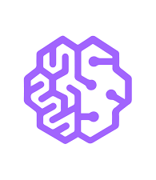


ML models on the Cloud: An introduction to Amazon SageMaker
Swaroop Malina
Notes:
Hello everyone, I am Swaroop and today I am going to introduce Amazon SageMaker and what are its capabilities with a small application.

Slide 2
Agenda
Introduction
Role in ML/AI
Using SageMaker
Pros and Cons
Summary
Notes:
We’ll see what’s SageMaker, it’s role in ML/AI, the application, and pros and cons

Slide 3
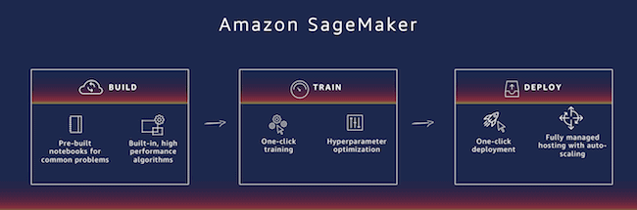
Introduction
Machine learning (ML) cloud service by AWS
Streamline and democratize the process of building, training, deploying, and managing machine learning models.
Pre-built algorithms, support for frameworks like TensorFlow and PyTorch, an IDE, and AutoML.
3
Notes:
Amazon SageMaker is a comprehensive machine learning (ML) cloud service offered by Amazon Web Services (AWS) that is designed to streamline and democratize the process of building, training, deploying, and managing machine learning models with fully managed infrastructure, tools, and workflows. Key features of Amazon SageMaker include a wide array of pre-built algorithms, support for popular frameworks like TensorFlow and PyTorch, an integrated development environment, and AutoML

Slide 4


SageMaker’s Role in ML/AI
Role in ML/AI

Slide 5
Data Preparation and Feature Engineering
Model Building and Training
Studio Notebooks
SageMaker Autopilot - No code
Deployment
Endpoints
Batch Transform
Multi-Model Endpoints
Monitoring
SageMaker Model Monitor
Amazon CloudWatch Integration
Custom Metrics and Dashboards
5
Notes:
As you all know machine learning is a multi stage and an iterative process, SageMaker has various tools in each stage from data gathering to deploying a model in production.
Monitoring
1.SageMaker Model Monitor automatically detects data and concept drift, making it easier for MLOps engineers to maintain model performance.
2.SageMaker Model Monitor seamlessly integrates with Amazon CloudWatch, enabling you to set up custom alarms and notifications based on monitoring results

Slide 6
Using Amazon SageMaker for Model Building, Training, Deployment, and Monitoring
6

Slide 7
Data preparation* Model Building - No code - Code Model Training Testing* Deployment Monitoring
CI/CD pipeline*
7

Slide 8
Dataset
Predicting if a delivery will be on time or not.
45,000 rows and 16 columns
Target: classification_ontime
total_items, zipcode, snow_depth, temperature, pressure, total_cloud_cover, relative_humidity, wind_speed
8

Slide 9
Code Approach
Amazon SageMaker Studio notebook with ml.t3.medium instance.
Dataset in S3
Data Import to Studio Notebook
EDA
9

Slide 10
Code Approach
Amazon SageMaker Studio notebook with ml.t3.medium instance.
Data Preprocessing
Hyperparameter
Tuning
Model training
Feature Selection
Cardinality Reduction
Standardization
Stratified 3-fold split
GridSearchCV
10

Slide 11
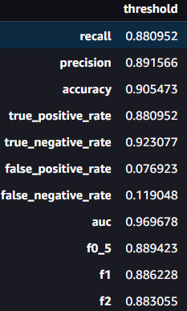
Code Approach
Amazon SageMaker Studio notebook with ml.t3.medium instance.
Model Evaluation
Model Deployment
Model Monitoring
ml.m4.xlarge
REQUEST and RESPONSE
ml.m4.xlarge
Monitor model quality with test set
11

Slide 12
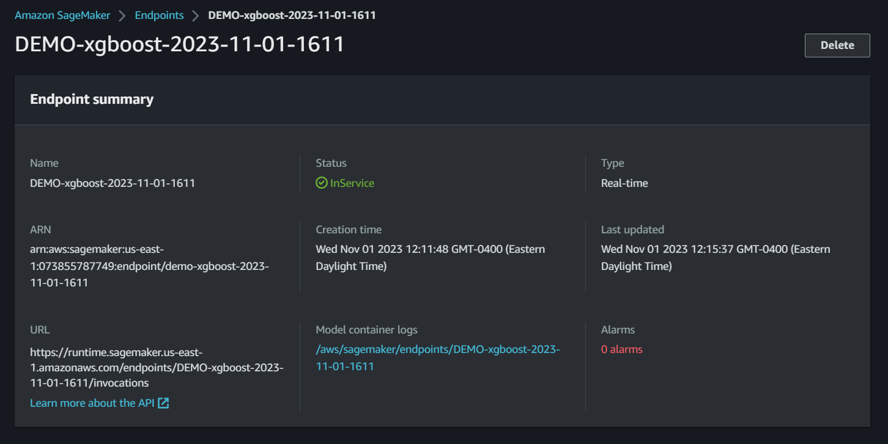
12

Slide 13
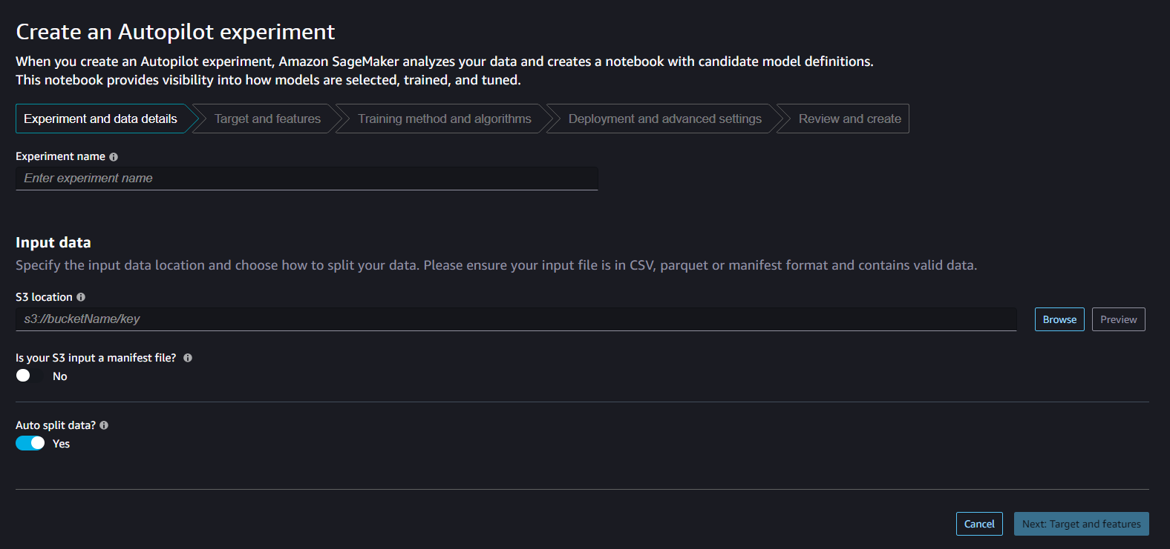
No Code Approach
Amazon SageMaker Autopilot
13

Slide 14
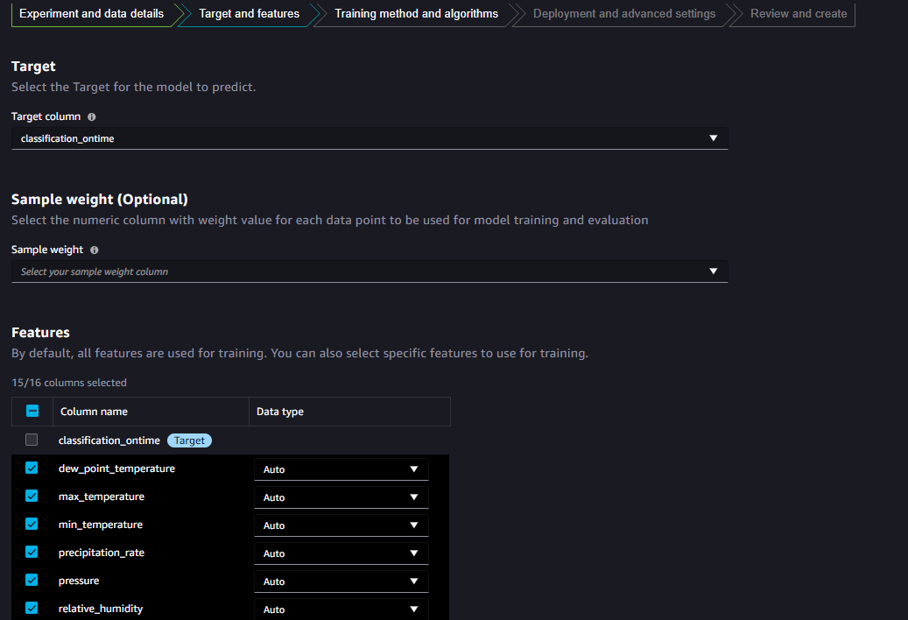
14

Slide 15
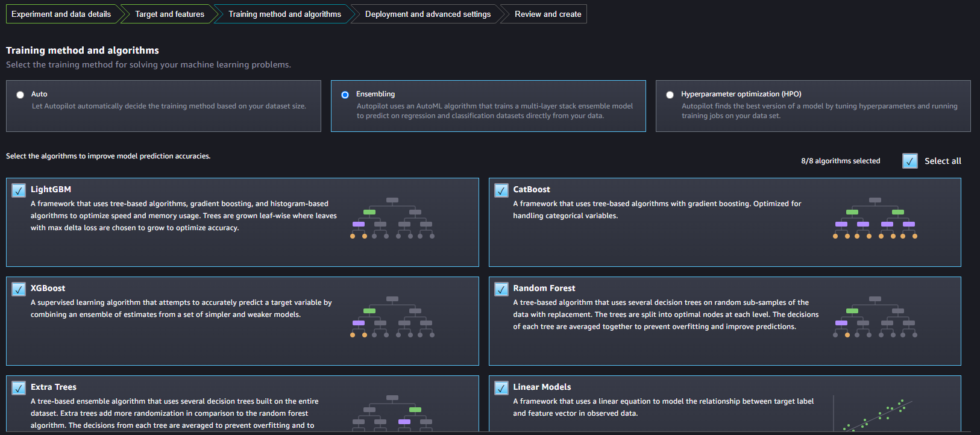
15

Slide 16
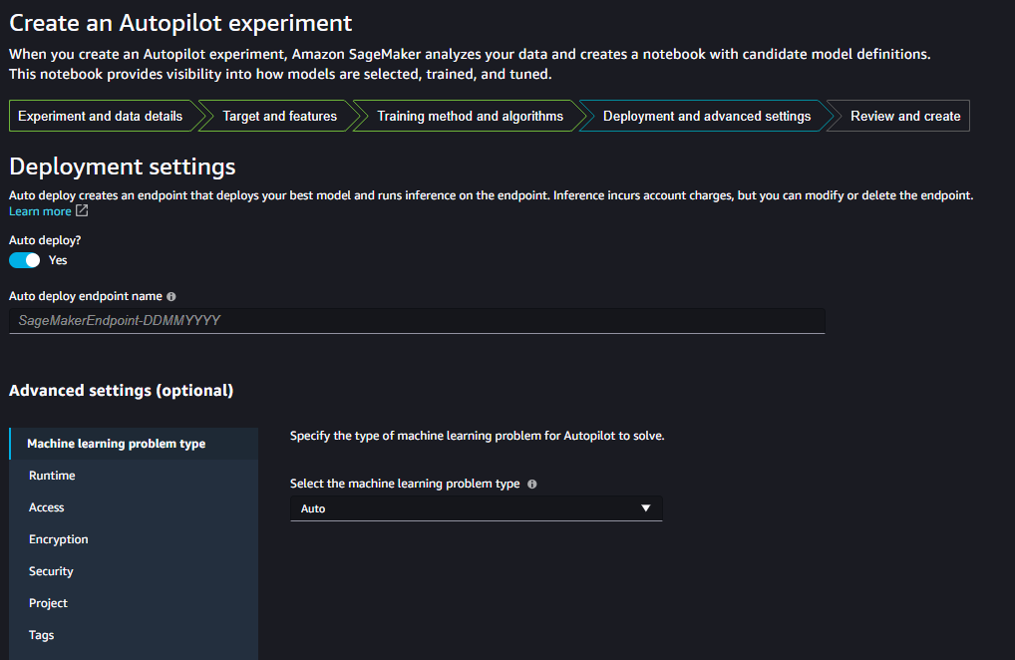
16

Slide 17
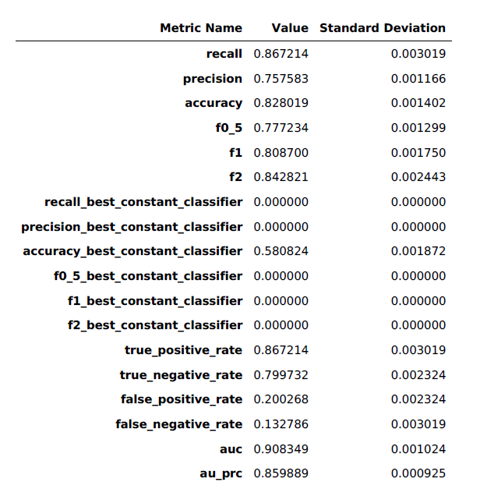
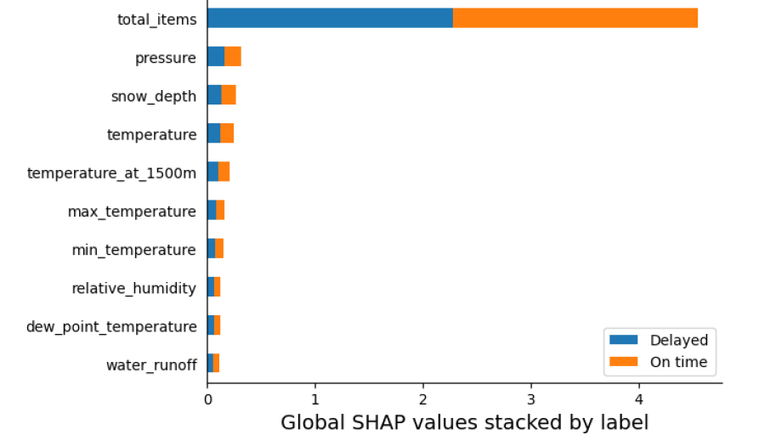
Reports by Autopilot
Explainability report
Performance report
17

Slide 18
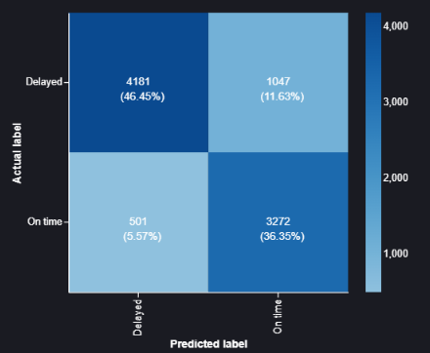
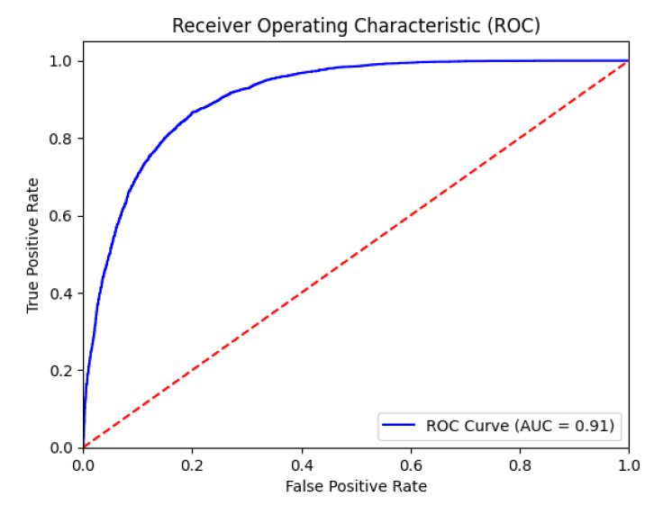
Reports by Autopilot
18

Slide 19
Pros and Cons
Scalability and Flexibility
Seamless Integration
End-to-End Platform
No-Code Approach
Customization Complexity
19
Notes:
Pros:
SageMaker enables effortless scaling of computing resources, allowing data scientists to handle projects of varying sizes without the complexities of resource management.
SageMaker seamlessly integrates with other AWS services, including Amazon S3, Lambda, and API Gateway, providing a holistic ecosystem for machine learning solutions. This integration simplifies data storage, data processing, and model deployment.
SageMaker offers an end-to-end platform for machine learning, covering data preparation, model development, training, deployment, and monitoring. This streamlining reduces the need for using multiple tools or services.
SageMaker Autopilot simplifies machine learning for users without extensive coding experience. It automates all the ML pipeline jobs.
Cons:
While SageMaker provides customization options, complex or highly specialized machine learning models may require more effort to develop and deploy compared to fully custom solutions.

Slide 20
Thank you
swaroopm@bu.edu

